Slide 1
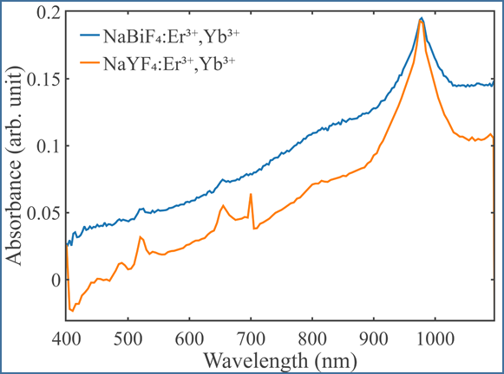
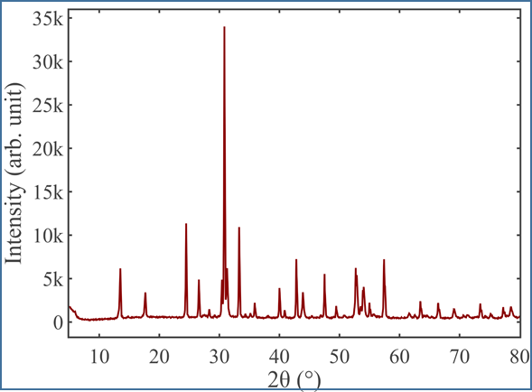
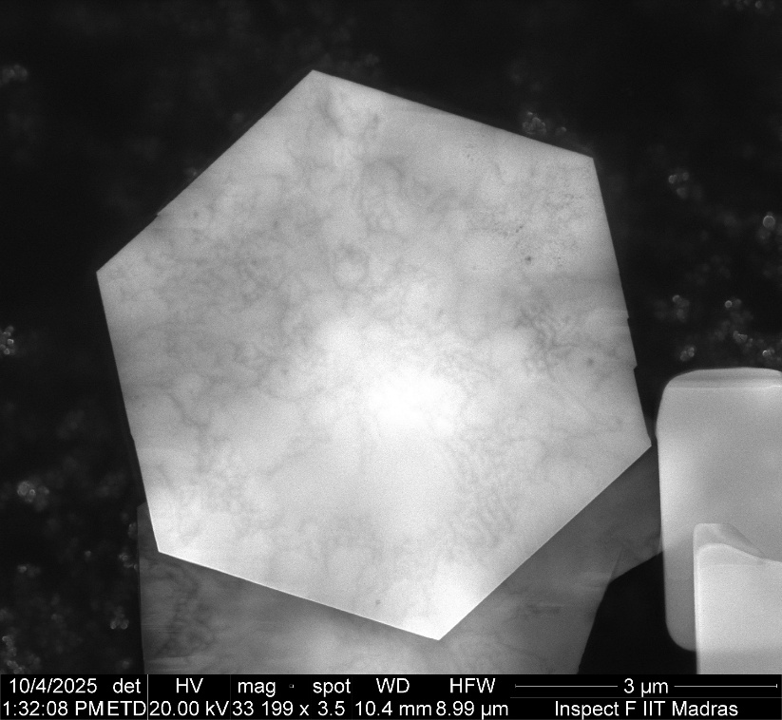
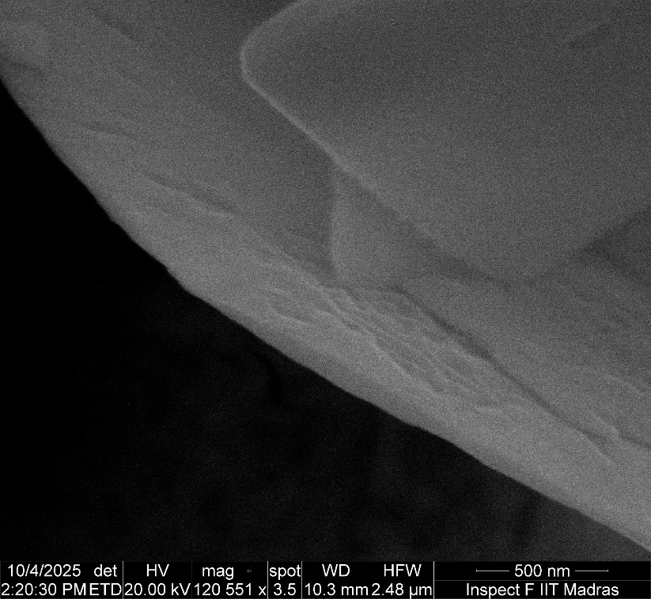
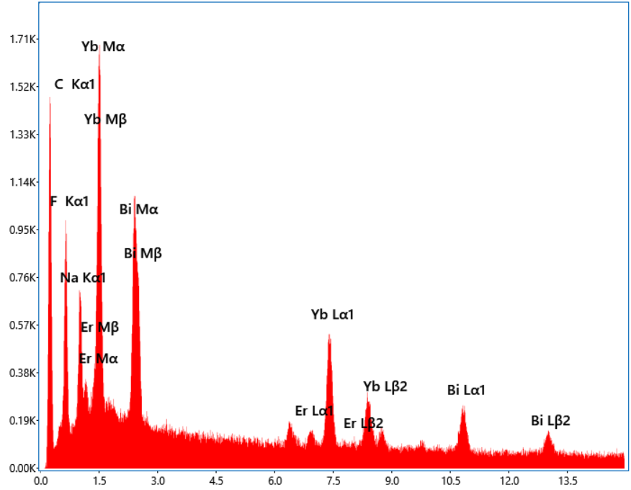
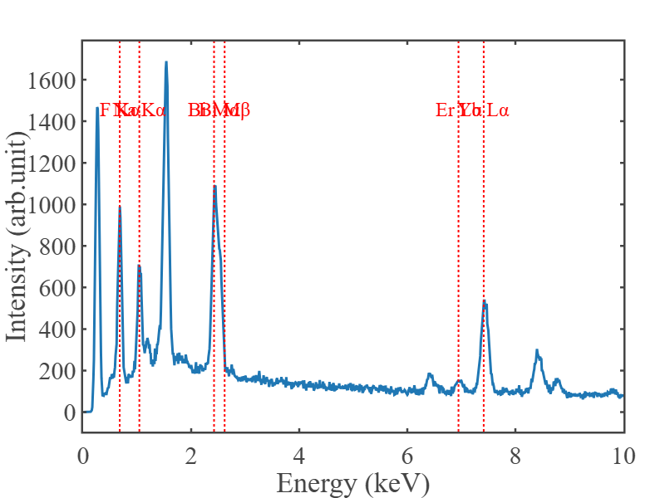
Raman Plot

Slide 2


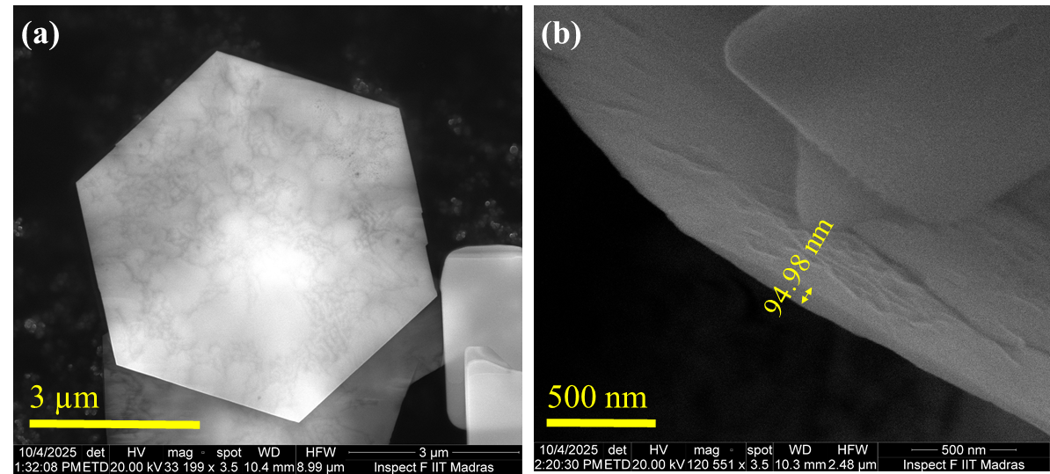
(a)
(b)
94.98 nm
3 µm
500 nm
(a

Slide 3
Raman Plot

Slide 4
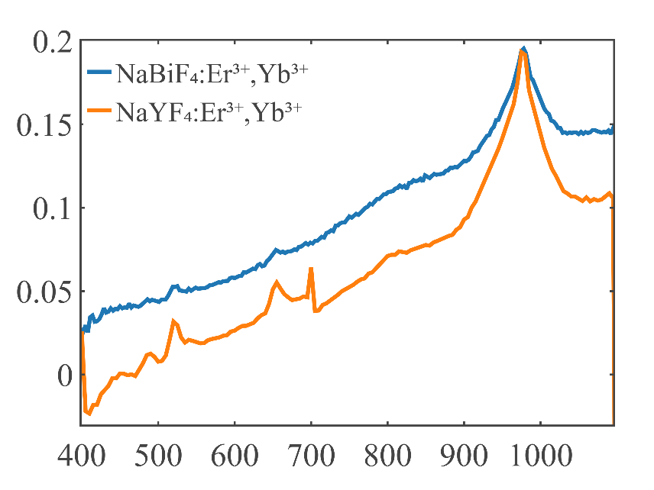
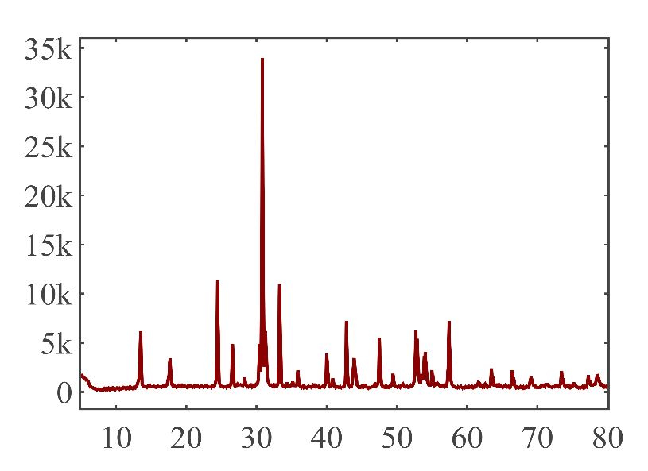
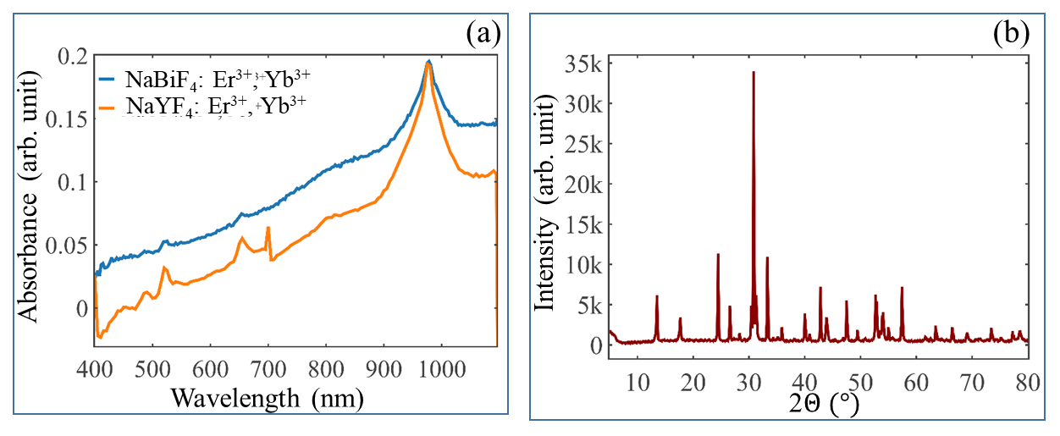
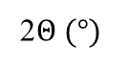
(a)
(b)
NaBiF₄: Er³⁺, Yb³⁺
NaYF₄: Er³⁺, Yb³⁺
Absorbance (arb. unit)
Intensity (arb. unit)
Wavelength (nm)
2$Θ (°)$
Intensity (arb. unit)
Wavelength (nm)

Slide 5
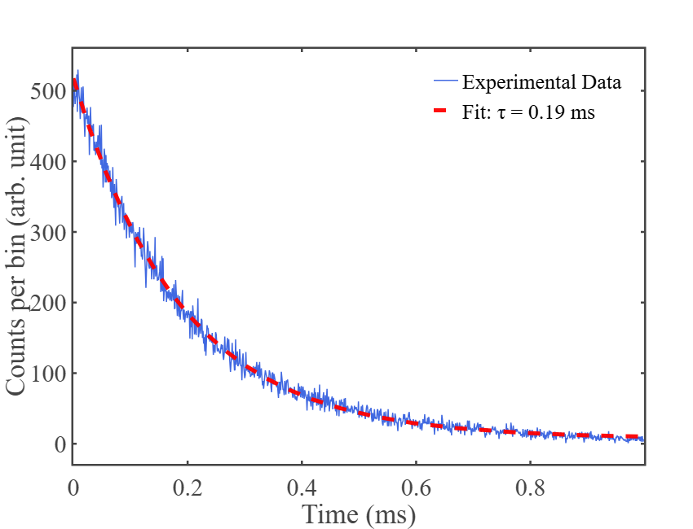
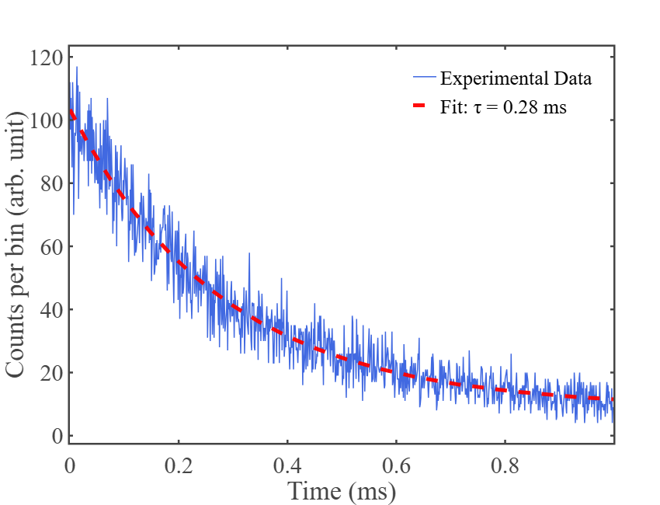
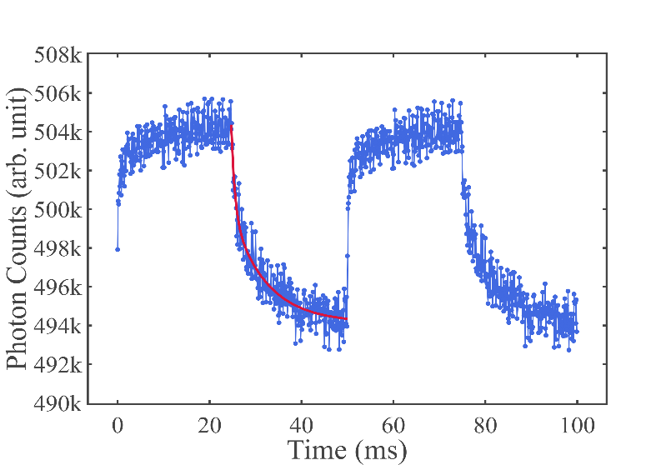
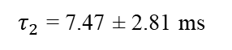
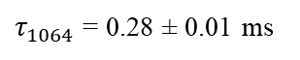
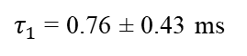
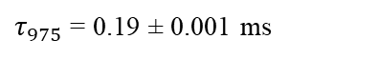
(a)
(c)
500
Experimental data
Fitted curve
ON
400
$τ_{975}$ = 0.19 ± 0.001 ms
OFF
975 nm laser pulse
300
Photon Counts (arb. unit)
ON
200
t = 50 ms
OFF
100
1064 nm laser pulse
0
(b)
0
0.2
0.4
0.6
0.8
1.0
(d)
120
Experimental data
Experimental data
Fitted curve
Fitted curve
506k
100
504k
80
$τ_{1064}$ = 0.28 ± 0.01 ms
502k
500k
Photon Counts (arb. unit)
Photon Counts (arb. unit)
60
498k
40
496k
20
494k
492k
$τ_{1}$ = 0.76 ± 0.43 ms
$τ_{2}$ = 7.47 ± 2.81 ms
0
0.2
0
80
100
0
0.4
0.6
0.8
1.0
20
40
60
Time (ms)
Time (ms)

Slide 6
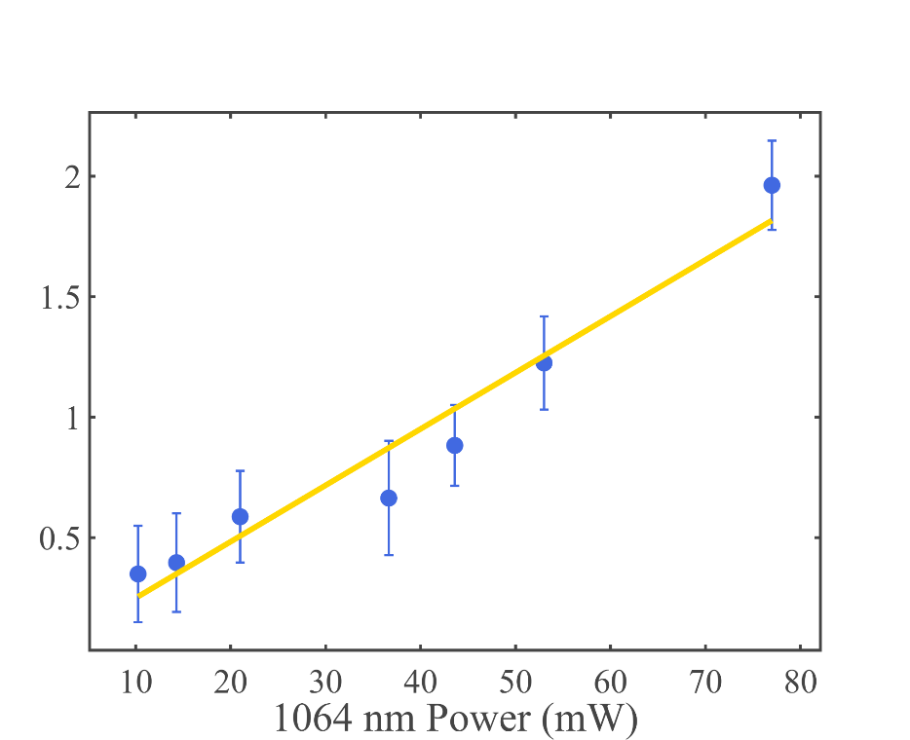
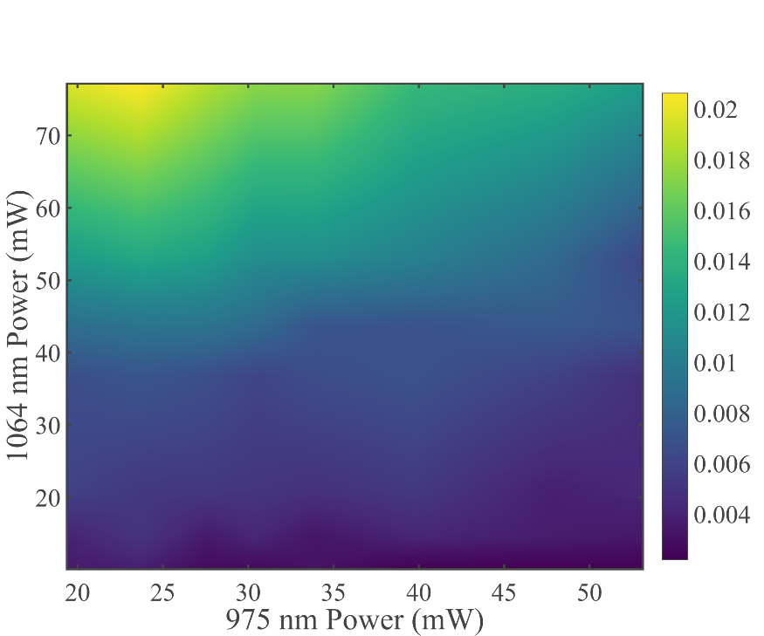
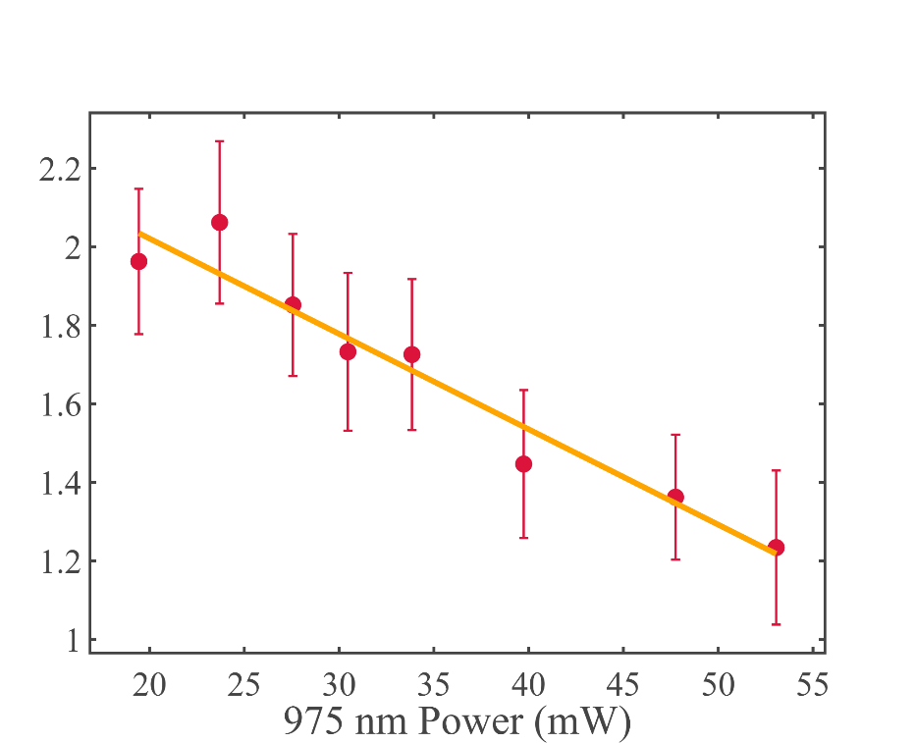
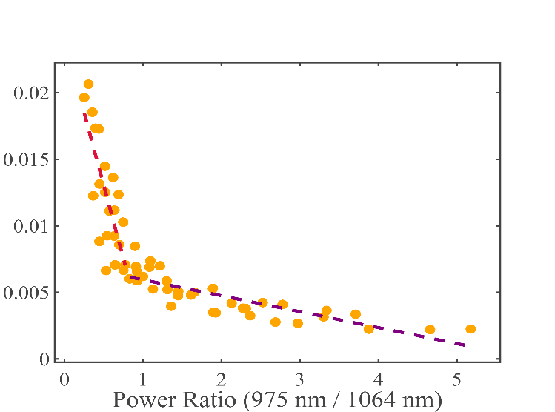
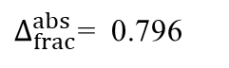
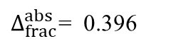
(a)
(c)
70
2
2
60
1.6
1.5
50
Per change, S (%)
Per change, S (%)
1064 nm laser power (mW)
1.2
1
40
30
0.8
0.5
$Δ_{frac}^{abs}$= 0.796
20
0.4
10
20
30
40
50
60
70
80
20
25
30
35
40
45
50
(b)
1064 nm laser power (mW)
(d)
975 nm laser power (mW)
2.2
2
2
Slope₁ = - 0.022
1.5
1.8
Per change, S (%)
Per change, S (%)
1.6
1
1.4
Slope₂ = - 0.012
1.2
0.5
$Δ_{frac}^{abs}$= 0.396
1
20
25
30
35
40
45
50
55
0
1
2
3
4
5
975 nm laser power (mW)
Power₉₇₅ / Power₁₀₆₄

Slide 7
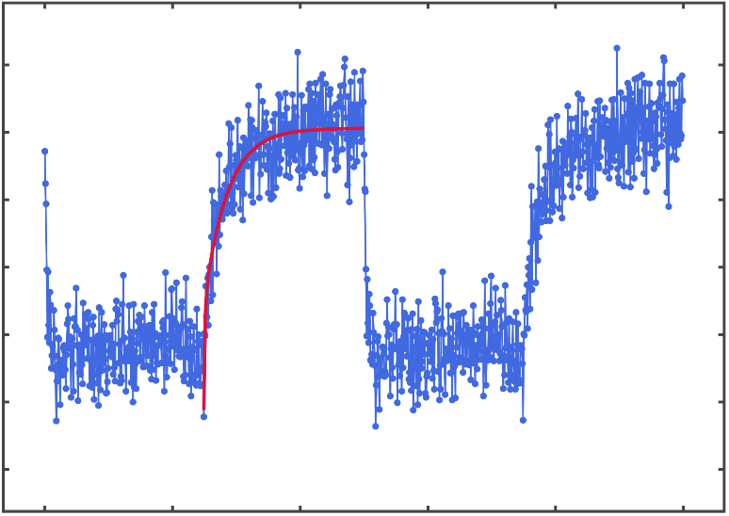
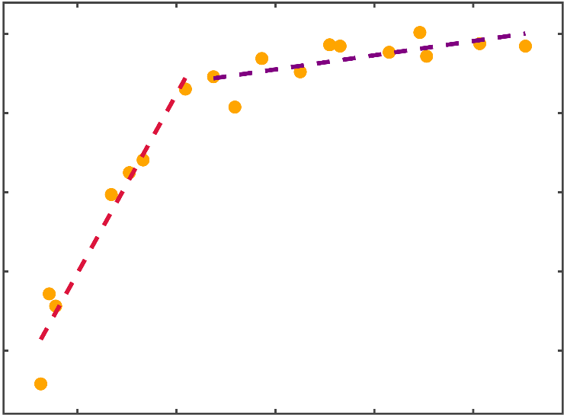
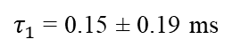
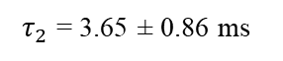
(a)
(b)
Experimental data
Fitted curve
0
2100
2000
-10
Slope₂ = 597.32
1900
-20
Photon Counts (arb. unit)
Per change, S (%)
1800
1700
-30
Slope₁ = 7538.13
1600
$τ_{2}$ = 3.65 ± 0.86 ms
-40
1500
$τ_{1}$ = 0.15 ± 0.19 ms
0
20
40
60
80
100
0.003
0.006
0.009
0.012
0.015
Time (ms)
Power₉₇₅ / Power₁₀₆₄

Slide 8
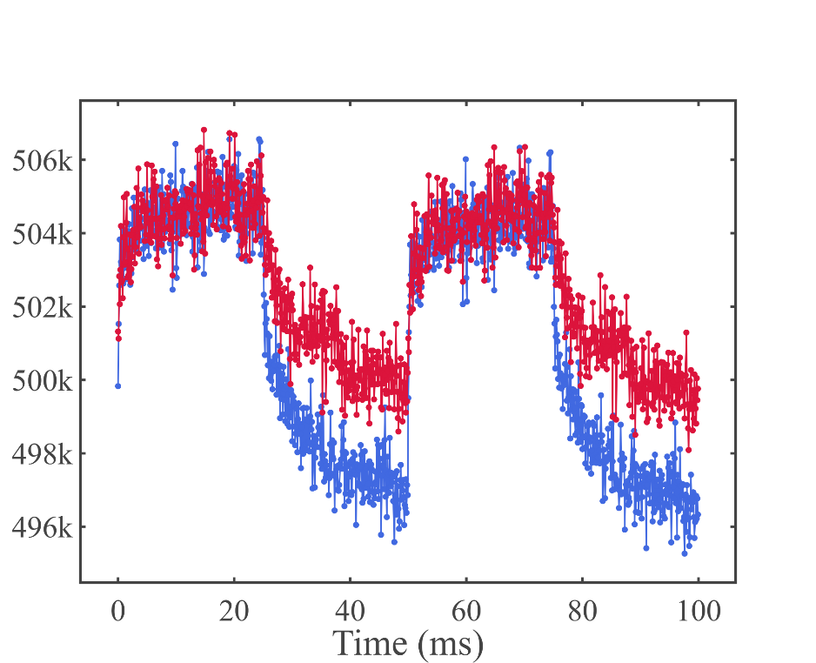
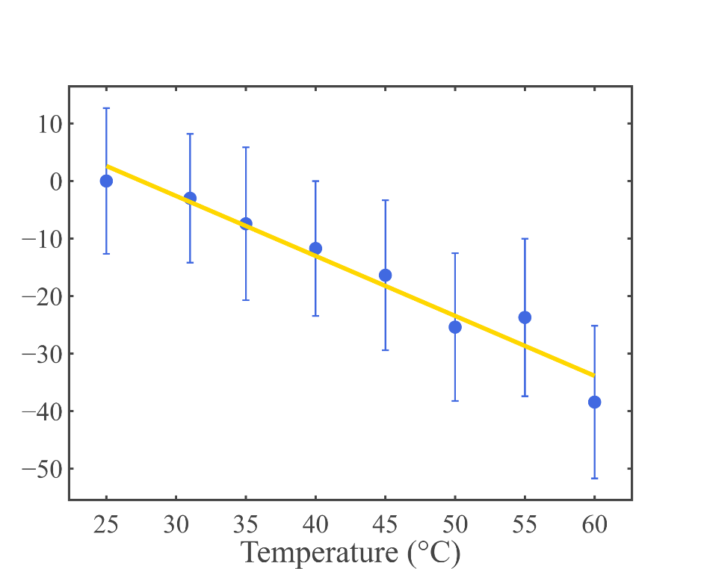
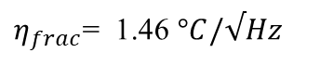

(a)
(b)
506k
10
504k
0
502k
-10
Photon Counts (arb. unit)
$$\frac{ΔS}{S_{ref}} [\%]$$
-20
500k
-30
498k
25º
-40
496k
60º
$η_{frac}$= 1.46 $°C/√Hz$
-50
0
20
40
60
80
100
25
30
35
40
45
50
55
60
Time (ms)
Temperature (º)

Slide 9
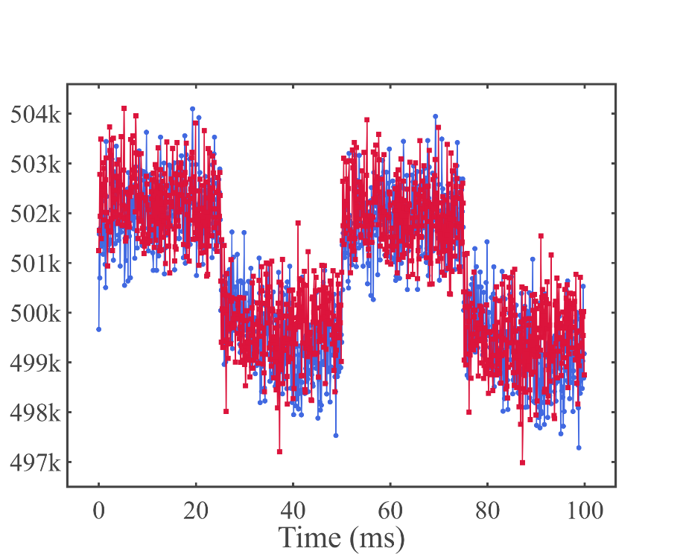
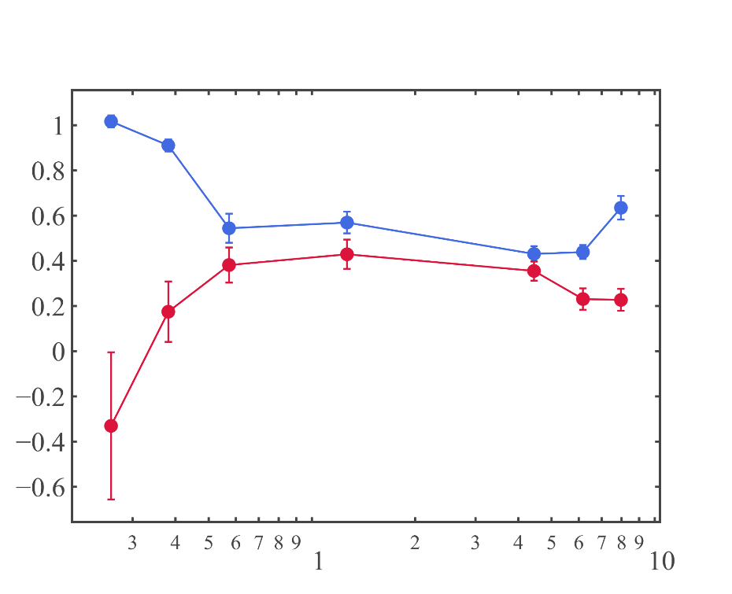
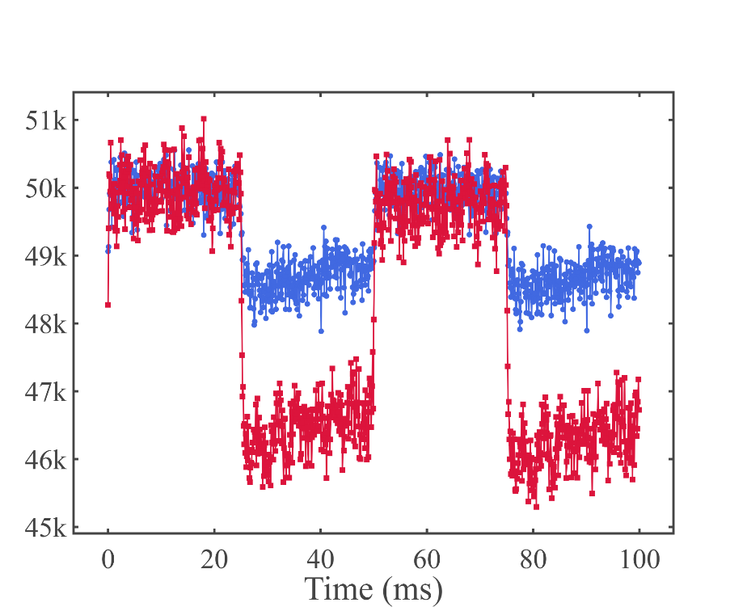
(a)
(b)
504k
Face on
503k
Figurative diagram of face on and side on configuration with its dipoles’ configurations
502k
501k
Photon Counts (arb. unit)
500k
499k
498k
497k
Parallel
Perpendicular
0
20
40
60
80
100
(d)
(c)
Time (ms)
1
Parallel
51k
Side on
0.8
50k
0.6
0.4
49k
S_{symlog}
0.2
Photon Counts (arb. unit)
48k
0
-0.2
47k
-0.4
46k
-0.6
Face on
Side on
45k
Parallel
Perpendicular
3
4
5
6
8
2
3
4
5
6
0
20
40
60
80
100
7
9
9
8
1
7
10
975 nm power (mW)
Time (ms)

Slide 11
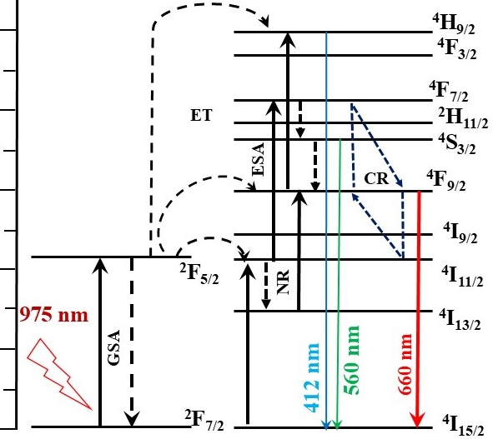
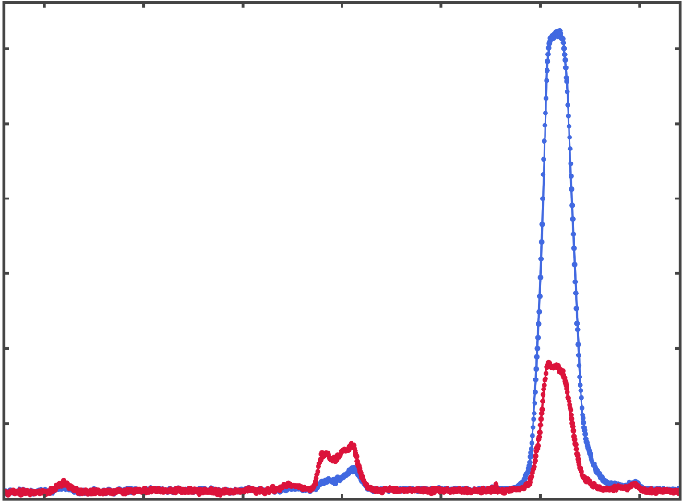
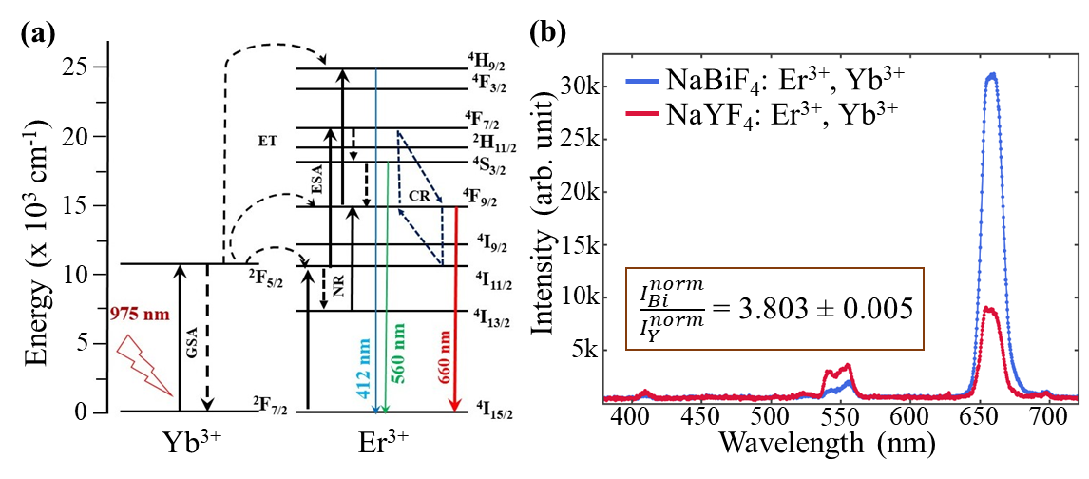
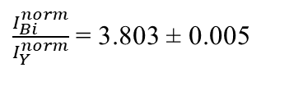
(a)
(b)
25
30k
NaBiF₄: Er³⁺, Yb³⁺
NaYF₄: Er³⁺, Yb³⁺
20
25k
15
20k
Intensity (arb. unit)
Energy (x 10³ cm⁻¹)
15k
10
10k
$\frac{I_{Bi}^{norm}}{I_{Y}^{norm}}$= 3.803 ± 0.005
5
5k
0
400
450
500
550
600
650
700
Yb³⁺
Er³⁺
Wavelength (nm)

Slide 12
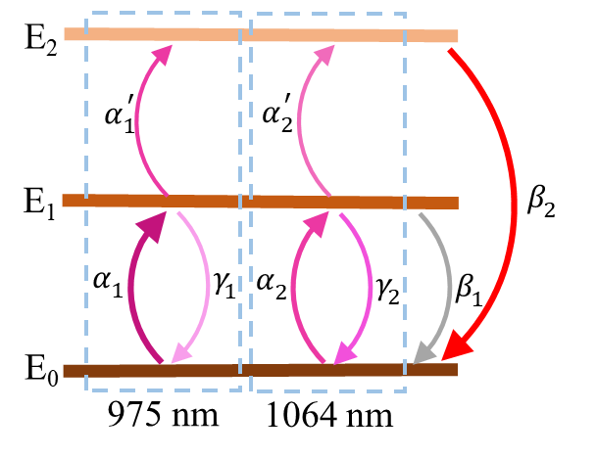
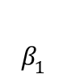
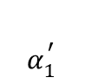
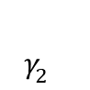
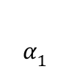
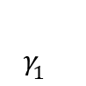
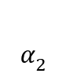
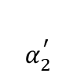
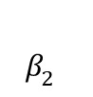
E₂
$$α_{1}^{′}$$
$$α_{2}^{′}$$
$$β_{2}^{}$$
E₁
$$α_{1}$$
$$γ_{1}^{}$$
$$α_{2}^{}$$
$$γ_{2}^{}$$
$$β_{1}^{}$$
E₀
975 nm
1064 nm

Slide 13
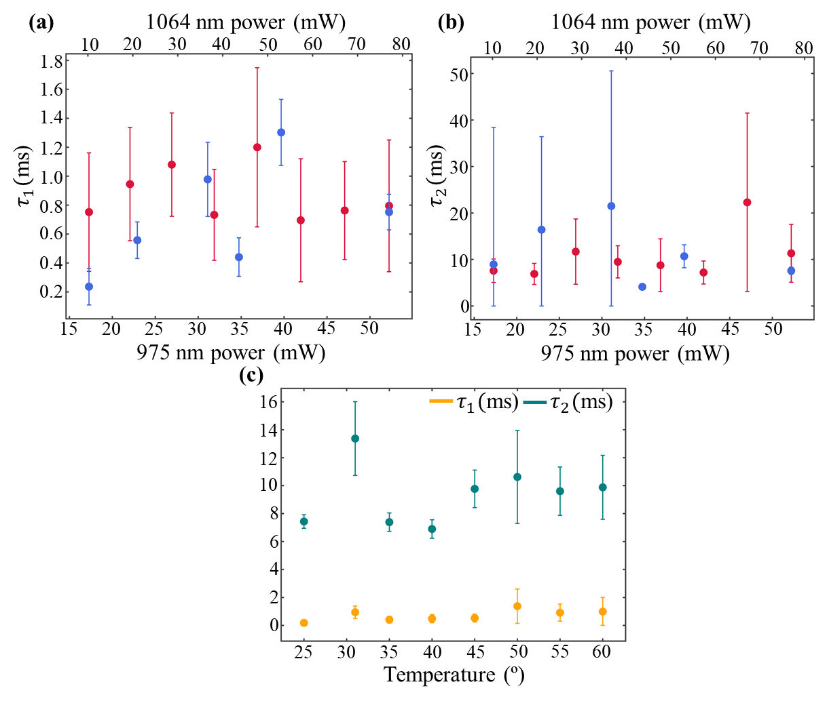
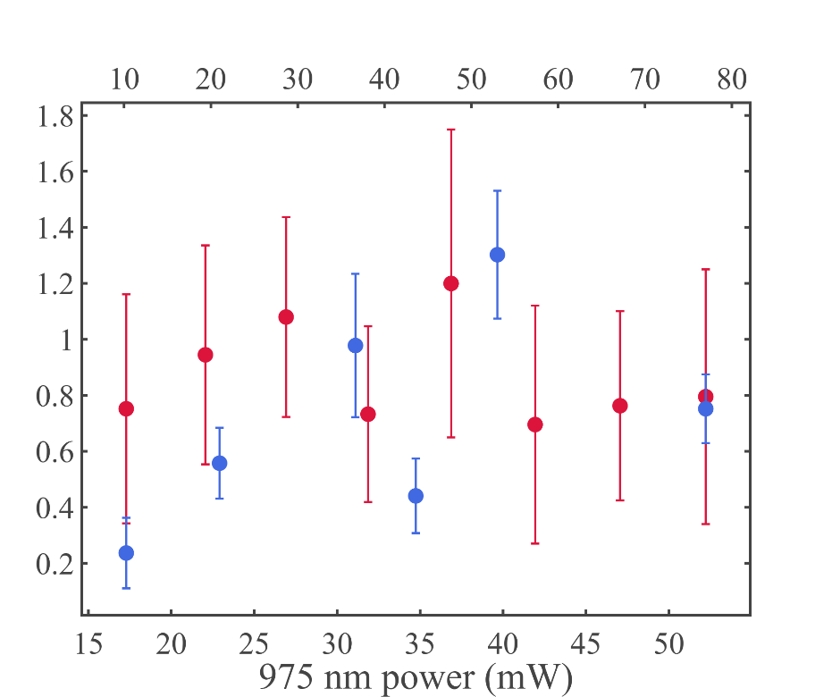
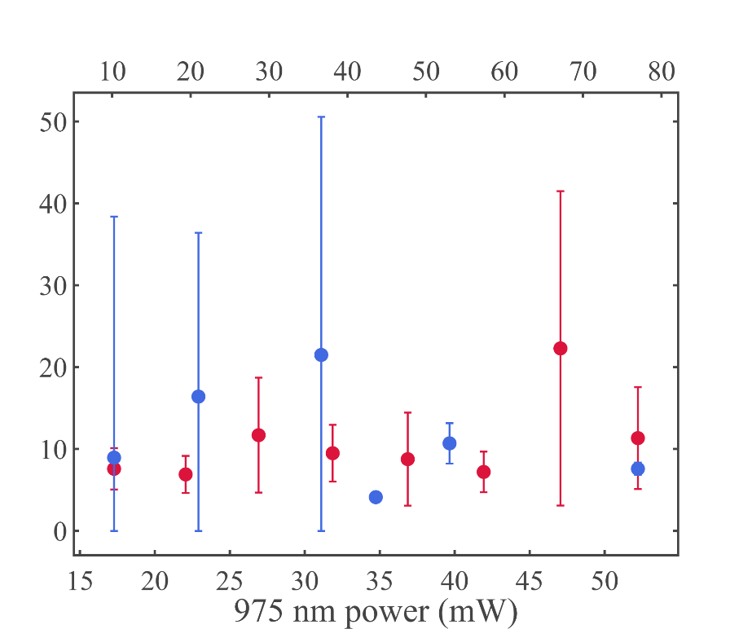





(a)
1064 nm power (mW)
(b)
1064 nm power (mW)
10
20
30
40
50
60
70
80
10
20
30
40
50
60
70
80
1.8
50
1.6
1.4
40
1.2
$τ_{1}($ms)
$τ_{2}($ms)
1.0
30
0.8
20
0.6
0.4
10
0.2
0
15
20
25
30
35
40
45
50
15
20
25
30
35
40
45
50
975 nm power (mW)
975 nm power (mW)
(c)
16
$τ_{1}($ms)
$τ_{2}($ms)
14
12
10
8
6
4
2
0
25
30
35
40
45
50
55
60
Temperature (º)

Slide 14




LED
Condenser
(10X, 0.25NA)
Sample Stage
Glass slide
Cover slip
NaBiF₄:Yb:Er
particle
Function Generator
Spectrometer
Objective
(100X, 1.3NA)
PBS
HWP 1
DM
Laser 1
(1064 nm)
90:10 BS
HWP 2
660 nm Filter
Flip Mirror
APD
Laser 2
(975 nm)
CMOS
Camera

Slide 15




OK
Modulator
START
END
200
1000
400
1200
600
800
DM 2
A
B
C
D
PBS 2
QPD

